Slide 1
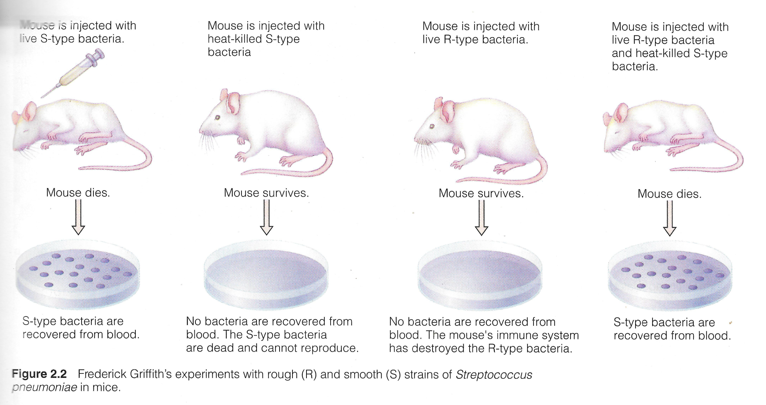
GRIFFITHS TRANSFORMATION EXPERIMENT

Slide 2
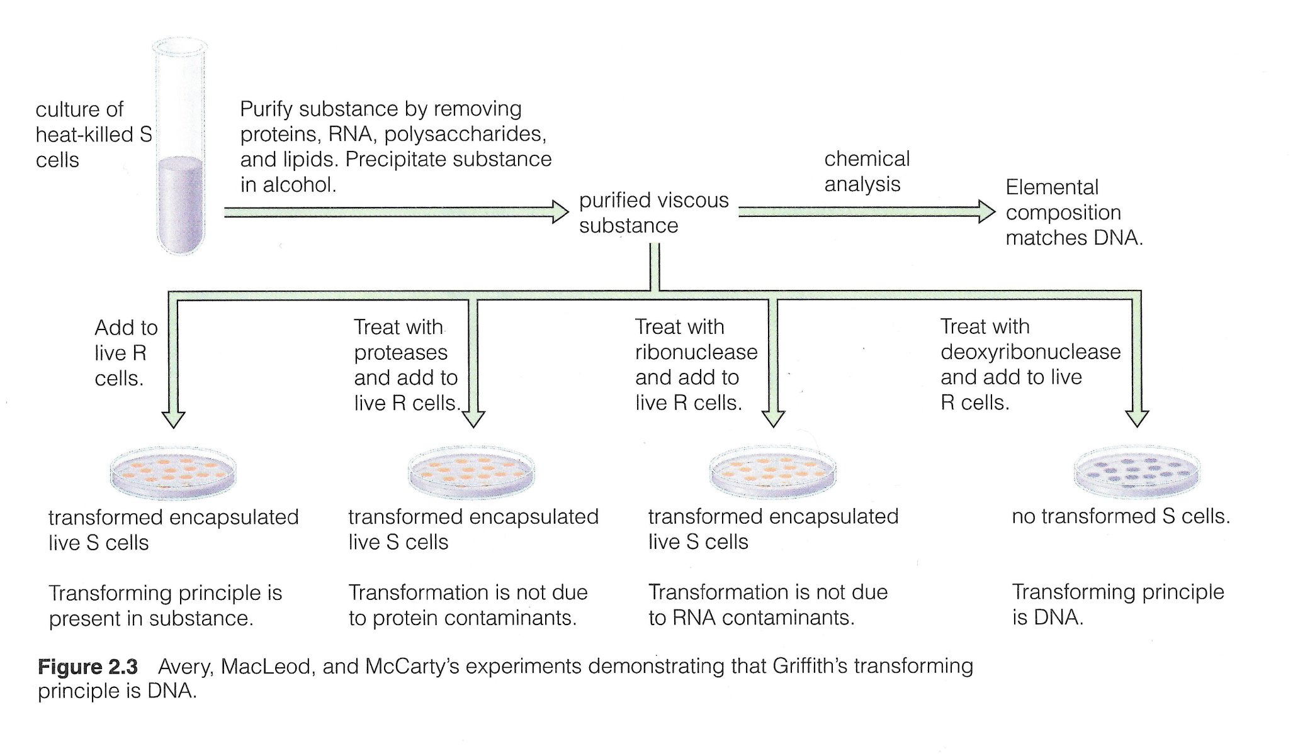
AVERY, MACLEOD, MCCARTYS EXPERIMENT

Slide 3
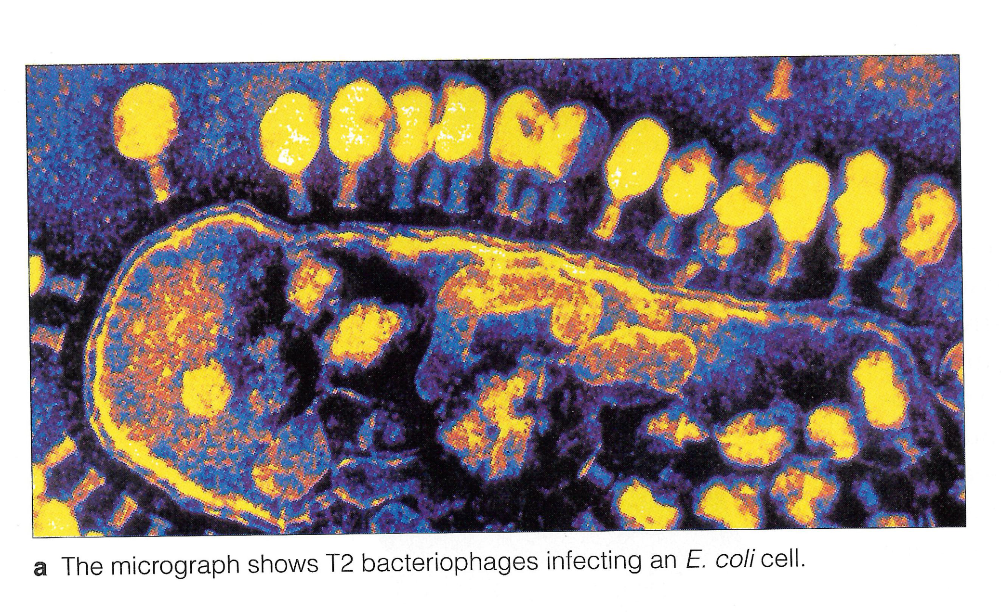
HERSHEY - CHASE EXPERIMENT

Slide 4
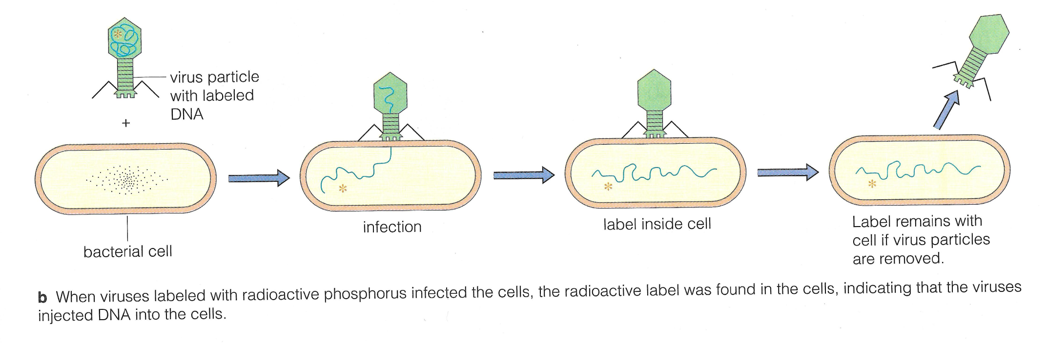
HERSHEY - CHASE EXPERIMENT

Slide 5
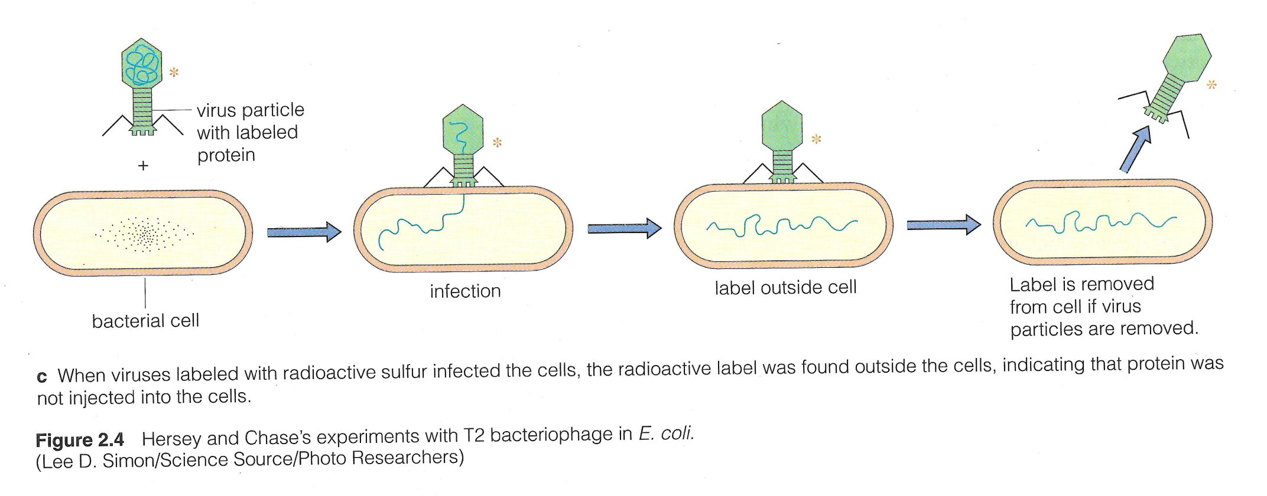
HERSHEY - CHASE EXPERIMENT

